Slide 1
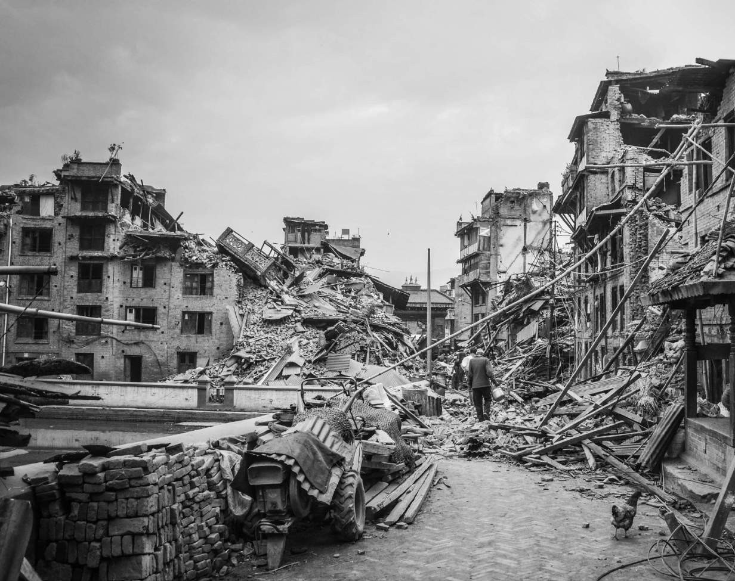




Classification and Clustering of worldwide Earthquake
Submitted By:
Debojyoti sahu Tanmoy Manna Biswajit Mandal Swadhin Maity
Udit Narayan Sahoo
Guided By:
Chandan Chakraborty
Dr. Sushovon Jana

Slide 2



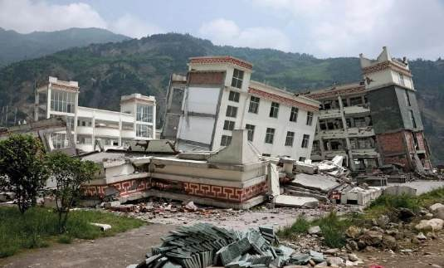
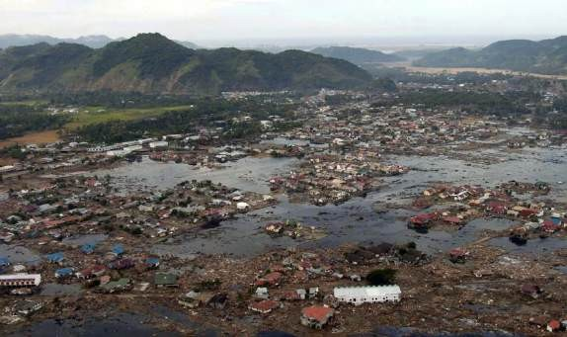
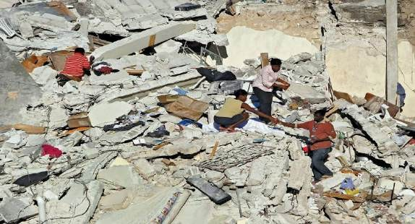
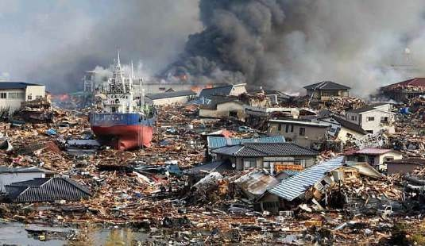
Unpredictable
Destructive
Sudden
Most feared
Yingxiu school, China-Sichuan earthquake, 12 May,2008 (mag-8)
Indonesia Earthquake aftermath, 26 dec,2004 (mag-9.1)
The Haiti Earthquake (Hispaniola), 12 Jan, 2010
Fukushima Japan, 6 mar,2022

Slide 3
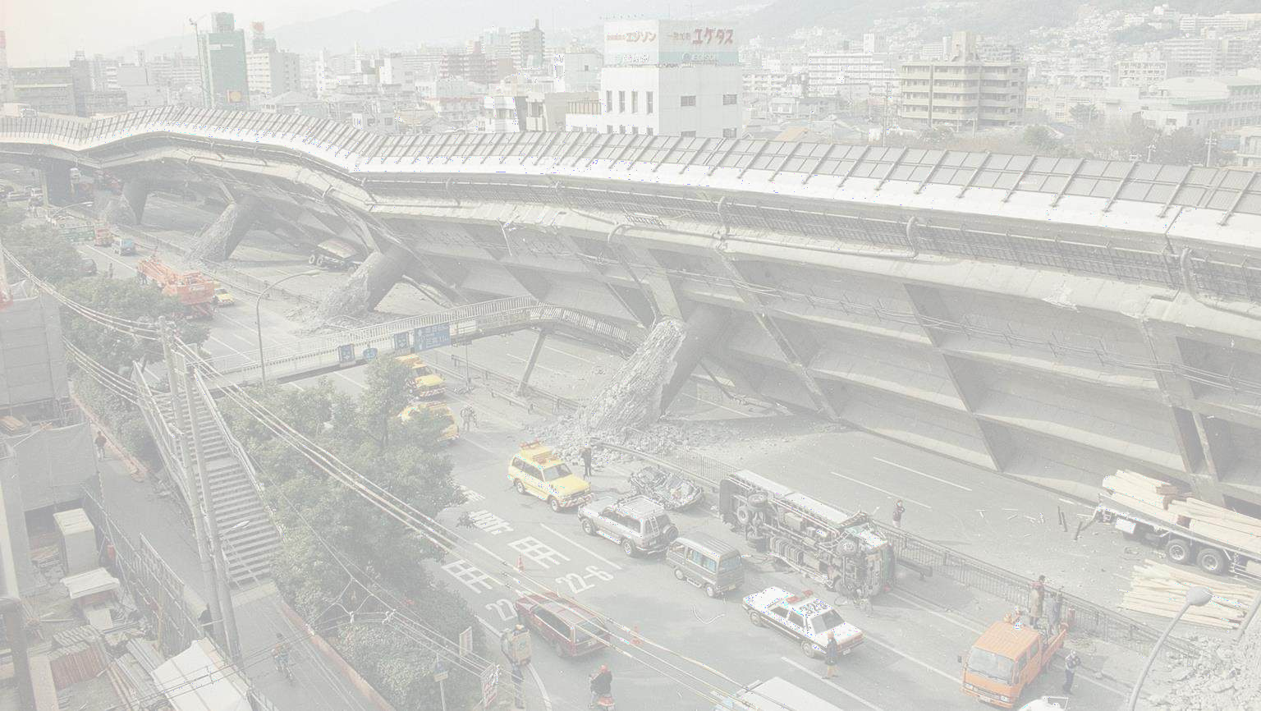




Can we identify the highly dense earthquake areas by understanding the distribution of earthquake?
Can we fit the seismic regions using clustering methods?
Is it possible to classify the earthquakes based on its characteristics?

Slide 4


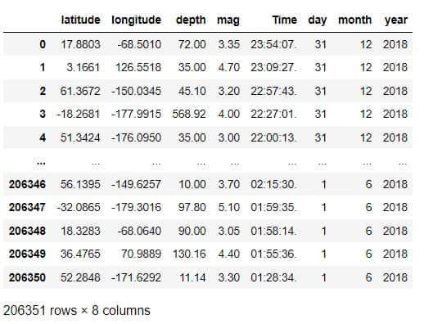
Depth: In seismology, the depth at which an earthquake occurs is called depth of focus or focal depth.
Shallow – “<50” , Intermediate - “50-300” Deep – “300-700”
Mag: Earthquake magnitude is a measure of the “size,” or amplitude, of the seismic waves generated by an earthquake source and recorded by seismographs. It is measured by Richter scale.

Slide 5




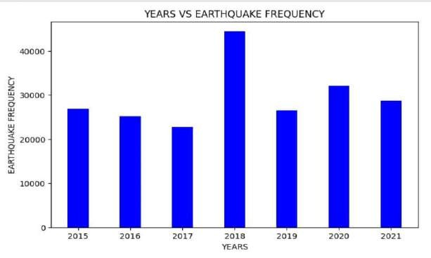
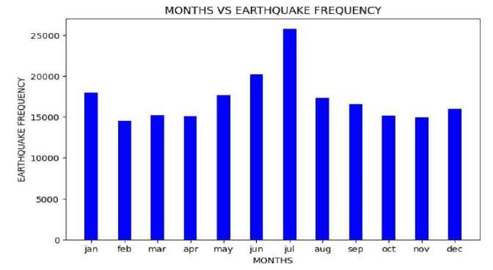
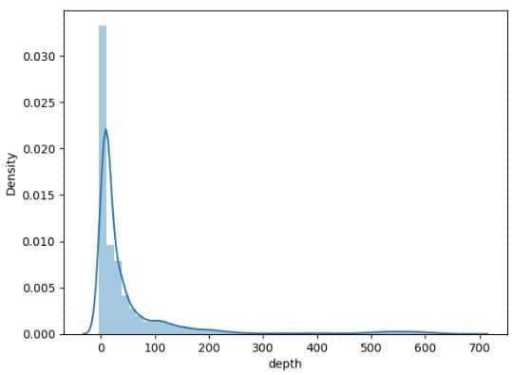
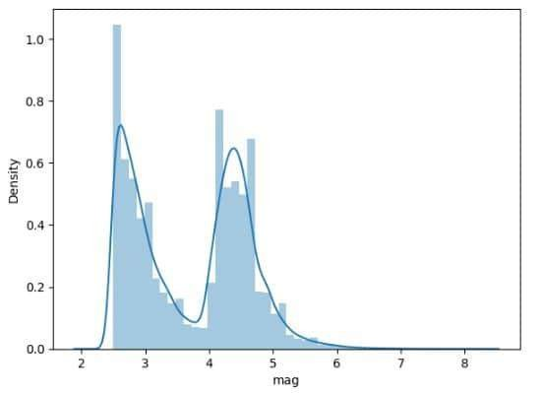

Slide 6


GIS (Geographic information system):
The domain of GIS comprises of a system that is competent enough to capture, store as well as analyse and display geospatial data, spatial relationships and various patterns.
GIS technology is of utmost importance in visualizing spatial data infrastructure.

Slide 7






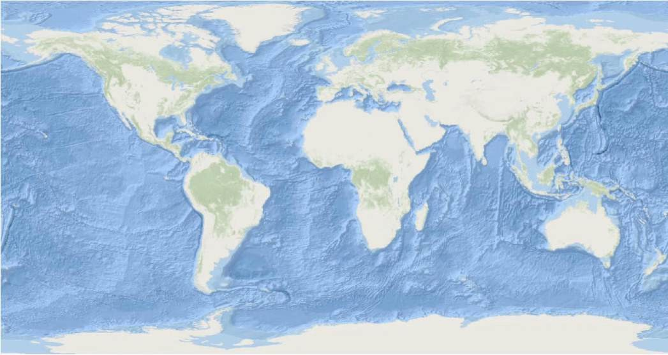

Overlay Analysis:
Earthquake points Seismic plates Active Volcano
We used ArcGIS software to visualize our special data
•
Firstly we plotted earthquake points on ocean base map
Then we plotted seismic plates and active volcano coordinates.

Slide 8
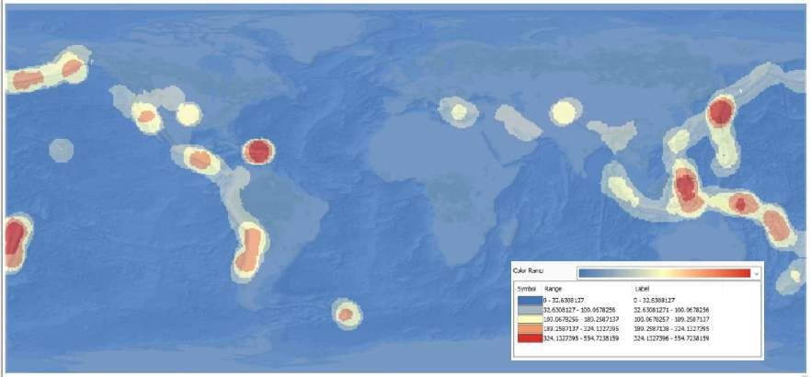
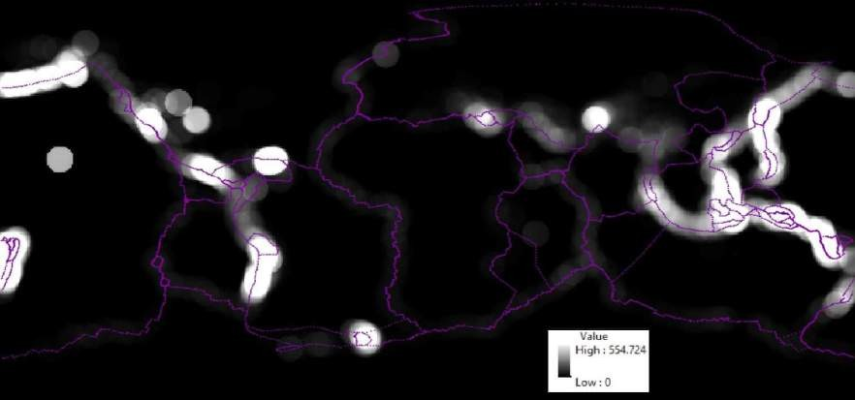

Hotspot Analysis:
•
In first figure highly dense areas are showed in red colour and lowly dense areas in blue.
In second figure highly dense areas are showed in white colour and lowly dense areas in black.

Slide 9
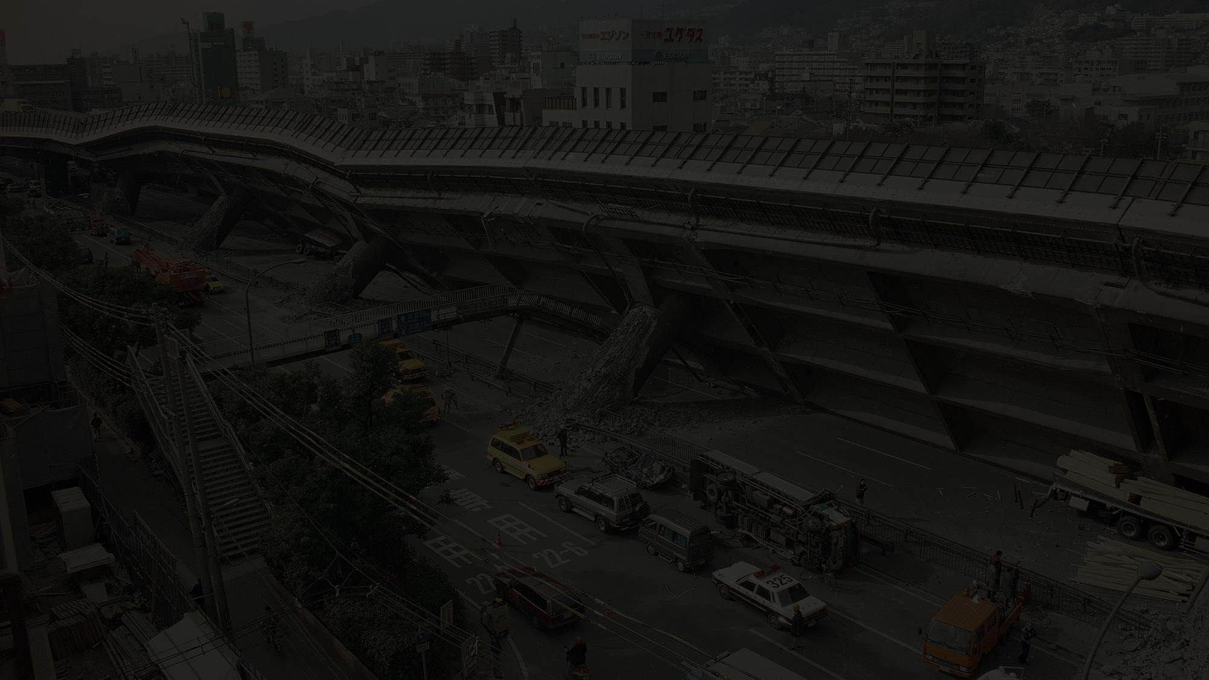


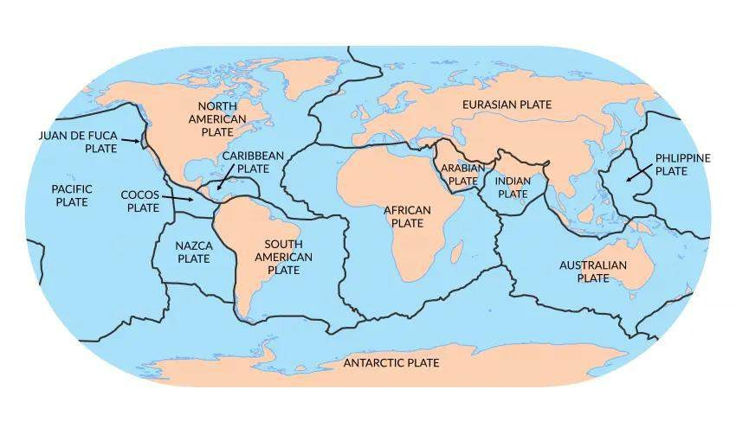

Alfred Wegner (1880-1930)
“The Origin of Continents and Oceans”
--1912
Tectonic Plates over Lithosphere

Slide 10
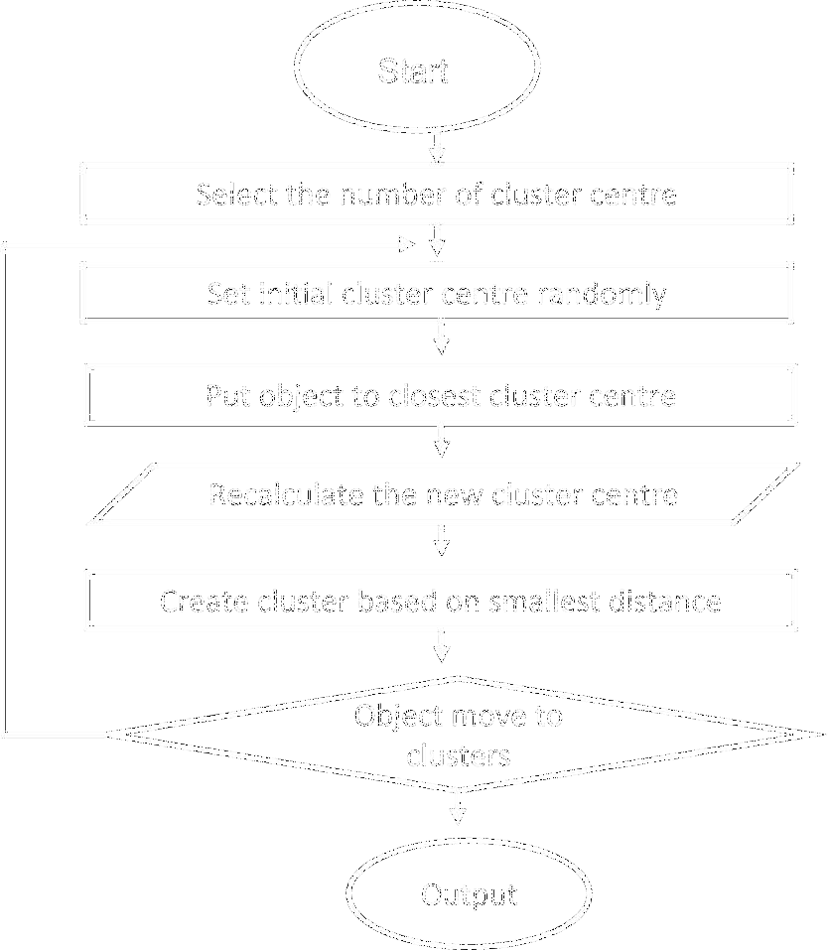
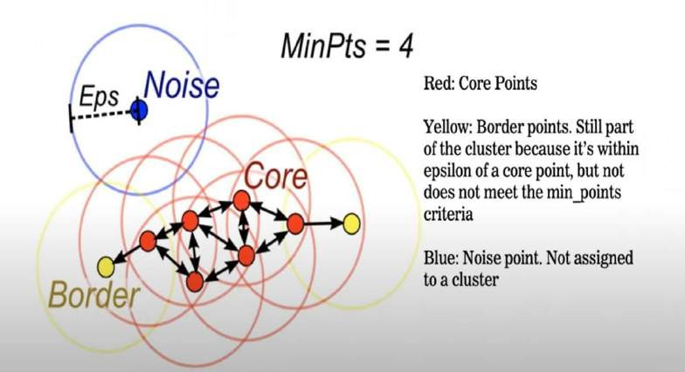
DBSCAN:
(Density Based Spatial Clustering of Application with Noise)
K-Means:

Slide 11



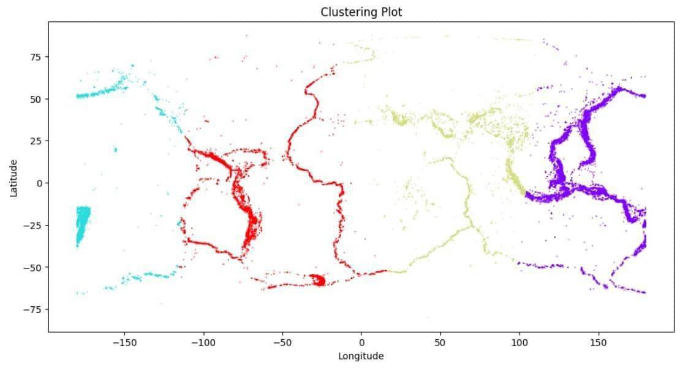
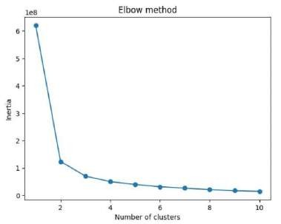
Due to its algorithmic characteristics; the shape of the cluster is convex and cannot be divided into strips.
The proportions of the cluster points are 23.6%, 44.8%,
16.98% and 14.43%
respectively.
For the above reason we move forward to DBSCAN
Silhouette Score: 0.533

Slide 12


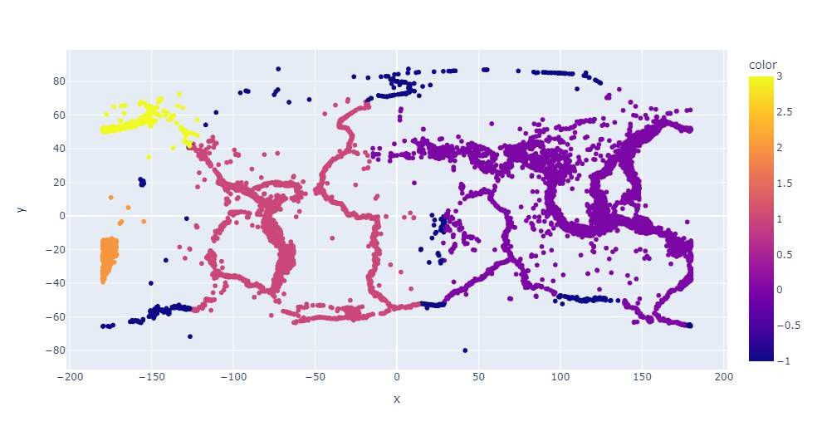
MinPts | ε | Number of Cluster | Noise(%) | Silhouette Score
100 | 5 | 23 | 7.78 | 0.388
 | 10 | 6 | 1.26 | -0.197
 | 15 | 2 | 0.304 | 0.299
 | 20 | 2 | 0.215 | 0.293
200 | 5 | 10 | 19.83 | 0.186
 | 10 | 10 | 6.511 | 0.421
 | 15 | 6 | 1.187 | 0.355
 | 20 | 2 | 0.415 | 0.267
400 | 5 | 9 | 26.18 | 0.154
 | 10 | 7 | 15.33 | 0.417
 | 15 | 7 | 6.99 | 0.431
 | 20 | 4 | 2.115 | 0.617
Here we can see that Eurasian Plate region, South American plate region and West Pacific plate region is all separated
But African plate region has splitted into two clusters.

Slide 13



K-Means
DBSCANN
Clustering Method ( for 4 clusters) | Silhouette Score
K-Means | 0.533
DBSCAN | 0.617
From visually and silhouette score we can say DBSCAN better fit the seismic plate regions

Slide 14
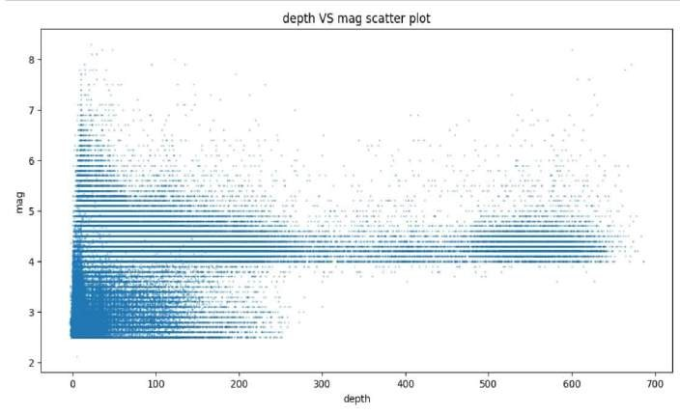
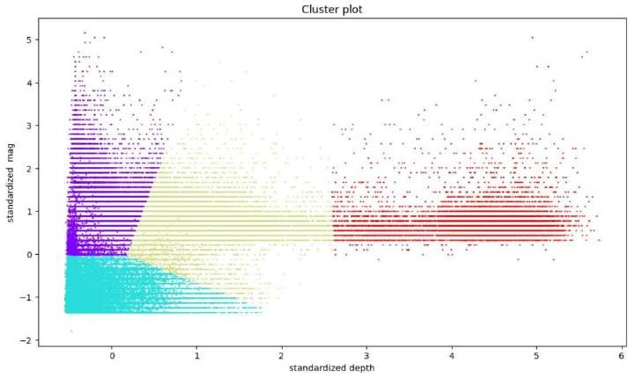
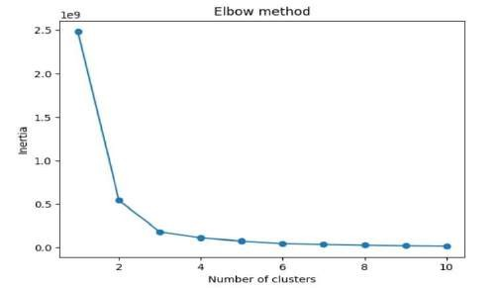
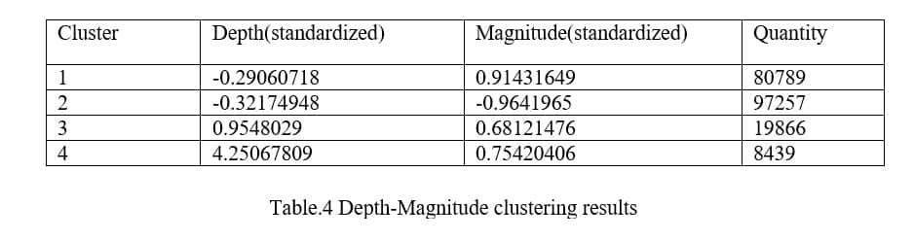

Slide 15


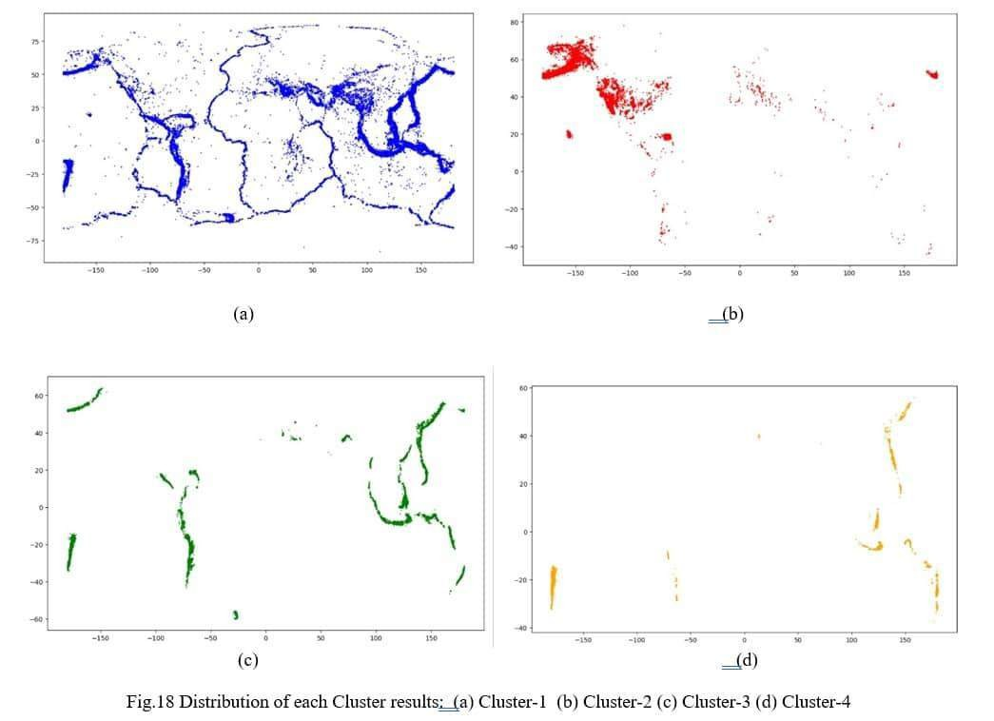
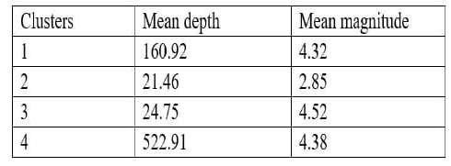
We can see that cluster 3 area has shallow mean depth and medium high mean magnitude.
So that theses areas are highly risked area.
The areas are Japan, Vietnam, West side of South Africa, Indonesia, Alaska .

Slide 16


1. From the heatmap analysis we found that Japan, Indonesia, Puerto Rico trench area are most earthquake prone area.
Can we identify the highly dense earthquake areas by understanding the distribution of earthquake?
Can we fit the seismic regions using clustering
methods?
Is it possible to classify the earthquakes based on its characteristics?
We used K-means and DBSCAN to fit the seismic regions and saw that DBSCAN can fit it better than K-means.
Yes we can classify the earthquake into 4 clusters
based on its depth and magnitude.

Slide 17




In the future, time series can be introduced into the research to extend the study of seismic distribution from the simulate surface to the space-time dimension.
At the same time, we can introduce regression analysis method to partially predict the earthquake.

Slide 18


The Origin of Continents and Oceans” work by Wegener.
E. Alpaydin, Introduction to machine learning, MIT press, 2020.
D. Kumar, R. Singh, R. Kaur, Spatial data analysis, in: Spatial Information Technology for Sustainable Development Goals, Springer, 2019, pp. 101-113.
J. P. D. Ordonez, A. d. J. P. Viloria, P. W. Rojas, Comparison of spatial clustering techniques for location privacy, in: 2019 IEEE Latin-American Conference on Communications (LATINCOM), IEEE, 2019, pp. 1-6.
Wen X, Zhang P, Du F, et al. (2009) “The background of historical and modern seismic activities of the occurrence of the 2008 Ms8.0 Wenchuan, Sichuan, earthquake.” Chinese Journal of Geophysics 52(2): 444-454.
Zhao Y, Liu Q, Wang C, et al. (2017) “Relationship analysis between the principal earthquake and the largest aftershock based on the linear regression.” Seismological and Geomagnetic Observation and Research 38(2): 71-76.

Slide 19


Acknowledgement isn’t simply a formality. It is an expression of heartfelt gratitude and
indebted to all those who have been associated with the development of the work.
We would like to express our profound and deep sense of gratitude to Dr. Sushovon Jana and Mr. Chandan Chakraborty for providing this project topic. Their guidance and suggestions helped a lot to perform intensive research and analysis. We owe them our gratefulness and gratitude for such opportunity.
We are greatly indebted to all the faculty members, who always stood by me in advance circumstances. Their encouragement and support helped to go beyond the limit and think out of the box.

Slide 20






